Slide 1

Light vs Dark: A Website Theme Case Study
This case study explores the impact of light versus dark themes on a bookstore's website, aiming to improve engagement and increase purchases through A/B testing and data analysis.
Author: Andrey Altukhov

Slide 2

Table of Contents
1
Given question and context
2
Statistics and method used to answer our question
An overview of the case study's main focus and background information.
Details on the data collection and analysis techniques employed.
3
Analysis Result
4
Actions we can take
Findings from the A/B testing and data analysis.
Recommendations based on the study results, including exposition, rising action, climax, and resolution.

Slide 3
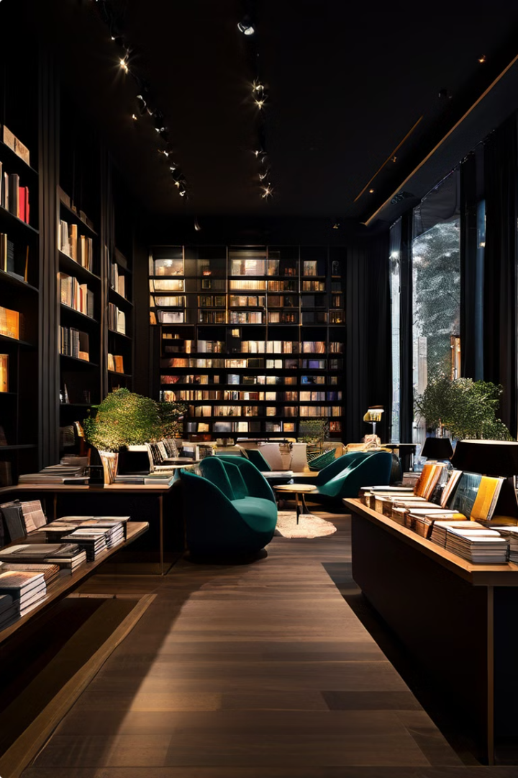
Exposition
1
Task
Test bookstore's website 2 themes; Light & Dark
2
Goal
Improve engagement to increase purchases
3
Data
Primary Source; collected from customers through the bookstore's website
4
Method
A/B testing for relevant metrics: Click Through Rate (CTR), Conversion Rate, Bounce Rate

Slide 4

Rising Action
An A/B test is a user experience research methodology useful for understanding user engagement and satisfaction of online features. The goal is to compare two versions of a feature and determine if there is a statistically significant difference in user engagement between them.
The null hypothesis (H0) is that there is no difference in user engagement between the two themes. The alternative hypothesis (H1) is that there is a statistical difference in user engagement between the two themes.

Slide 5

Why do we Use a T-Test to answer our question?
T-Test Purpose
Compares means of two groups
Applicability
Suitable for A/B testing scenarios
Advantage
Determines statistical significance
Outcome
Helps decide between H0 and H1

Slide 6

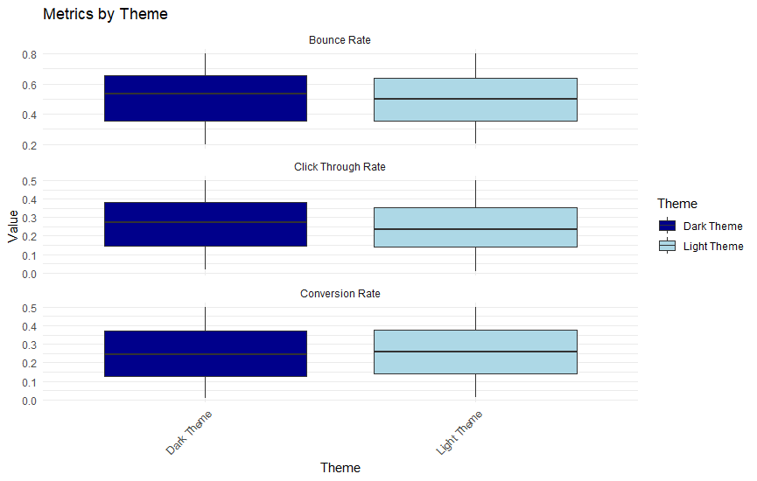



Climax
and Resolution
Results
H0 rejected for CTR. H0 not rejected for Conversion Rate and Bounce Rate. Both Dark and Light Theme offer a similar performance, with a slight advantage for DT.
Recommendation
Offer users the possibility of choosing their personal favorite theme.
Implementation
Integrate theme selection option into website design.
Future Steps
Monitor user preferences and continue analyzing engagement metrics.

